Slide 1

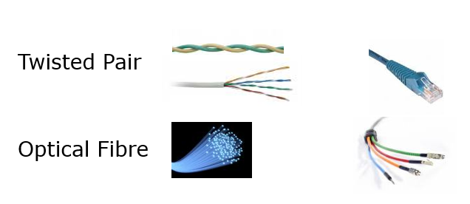
OSNF
Network Cabling
Lecture
Diploma in CSF/IT
Year 1 (2021/22), Semester 2
Notes:
Left-hand Bar – Replace FSP by your module code and X by the lecture number.
Replace Lecture Title
Replace < Module Name >
Replace Year and Semester if necessary

Slide 2
Objectives
At the end of this lecture, you will be able to
Describe how data is transmitted between devices
Understand the characteristics of transmission media: STP, UTP and optical fibre
Understand the factors affecting the performance of network cables
Identify and select network cables

Slide 3
Topics
Data Transmission
Transmission Media vs Network Cabling
Factors affecting Cable Performance

Slide 4
Data Transmission
Data is transmitted in bits
Depending on physical (PHY) layer specification, bits can be transmitted one at a time or multiple bits at a time
The bits are transmitted in the form of signals which can be in one of the following forms:
Electric current or voltage,
Electromagnetic waves
Radio waves
Light

Slide 5
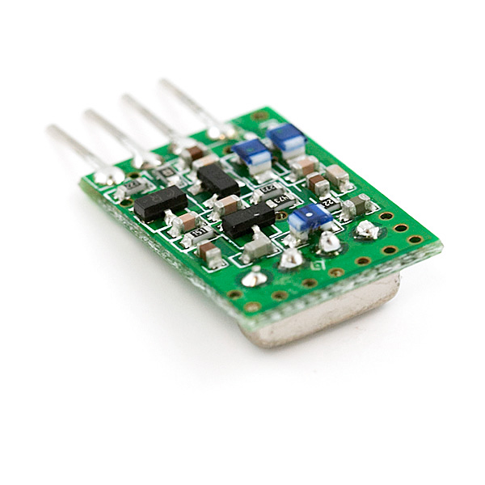
Data Transmission – cont.
The signals travel from the transmitter of the sender to the receiver of receiving devices through a transmission medium.
Transmitters and receivers are electronic circuits in the NICs of their respective devices
Common transmission media are copper and optical fibre
Radio wave and infrared are considered unguided (without wires) transmission media

Slide 6

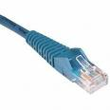


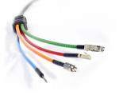
Transmission Media
The two common type of transmission media are:
Twisted Pair
Optical Fibre
Notes:
Optical Fibre is also known as Fibre Optics

Slide 7
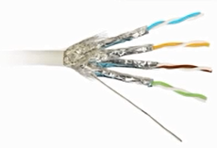
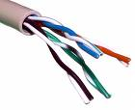
Twisted Pair
Two types of twisted pair
Shielded Twisted Pair (STP)
Besides twisting, to further improve noise rejection, a foil or wire braid "shield" is woven around the twisted pairs
Unshielded Twisted Pair (UTP)
Because of its cheaper cost, it is the most widely used
Notes:
Some points to ponder over
What is the key advantage of UTP compared to STP and why UTP is still widely used for LAN?
Its performance can match that of the STP for most LAN in normal environment although it doesn’t have the shield to cut down EMI.
Its low price and flexibility (thinner) makes it the most suitable choice in LANs where security and interference are not the issues.

Slide 8
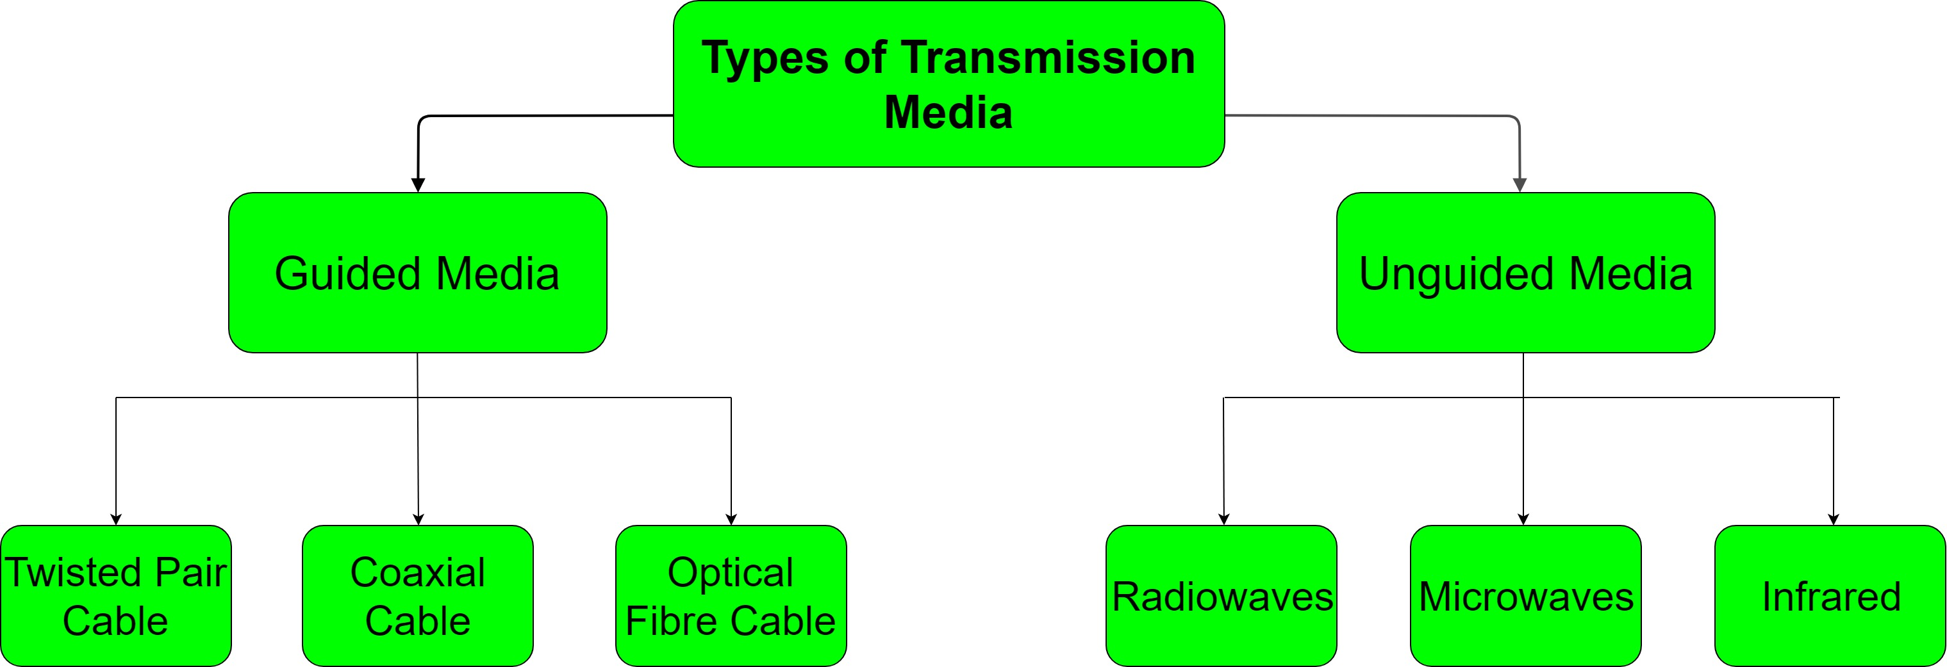
Types of Transmission Media
We have covered Twisted Pair and Optical Fibre.
Notes:
Optical Fibre is also known as Fibre Optics

Slide 9
Transmission Medium vs Network Cable
Network cable uses transmission medium and follows standards.
Example: RJ45 cable uses Twisted Pair with RJ45 connectors
Network cables are used for connecting up devices in the network.

Slide 10
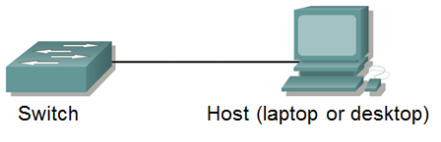
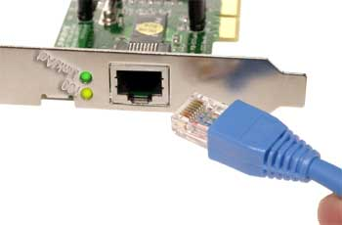
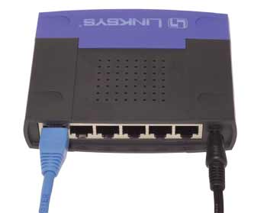
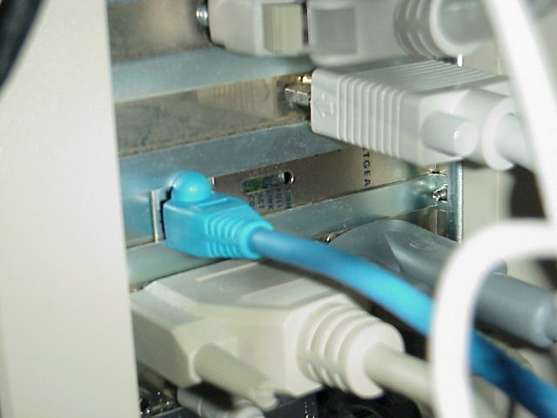
Connection using UTP Cables (with RJ45 connectors)
Connecting a host to switch with a UTP cable
An NIC with RJ45 socket
A desktop connected to a network using a UTP cable
A switch with RJ45 sockets
Notes:
You have used UTP cables in your practical session.

Slide 11


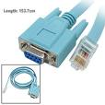
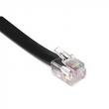
UTP (Unshielded Twisted Pair)
Cables without a shield are called unshielded twisted pair or UTP.
UTP is most commonly used as RJ45 cable.
It consists of 4 pairs (8 wires) connected to RJ45 connectors on both ends.
RJ45 cables connect LAN devices e.g. PC to Switch.
Another type of RJ45 cable, rollover cable uses UTP has one end with a RJ45 connector and the other end a serial connector.
Another widely used cable using UTP is the telephone wire known as RJ11, which consists of only 2 pairs. It looks like the RJ45 cable, except the connectors are smaller. It is also used for ADSL broadband connection.
RJ45 cable
Serial-RJ45 cable
RJ11 cable
Notes:
Rollover cable (also known as Cisco console cable) is used to connect a computer terminal to a router's console port.
This cable is typically flat (and has a light blue colour) to help distinguish it from other types of network cabling.

Slide 12
UTP (continued)
UTP is cheap and flexible making it easy to install hence effective for most LAN.
There are many categories of UTP:
Cat 1 : Carry voice but not data (telephone network) RJ11 cable
Cat 2 : Up to 4Mbps
Cat 3 : Up to 10 Mbps obsolete
Cat 4 : Up to 20 Mbps
Cat 5 : Up to 100 Mbps - almost obsolete
Cat 5e (enhanced) up to 1 Gbps
Category 6: up to 10 Gbps (but distance is limited to 55m)
Cat 6A (augmented) – up to 10 Gbps (can go up to 100m)
Note: Cat 7 is the shielded version of Cat 6
A UTP category determines the max speed and distance supported. For example, a Category 6 RJ45 cable can support speed of 10 Gbps up to 55m (or support speed of 1 Gbps up to 100m).

Slide 13
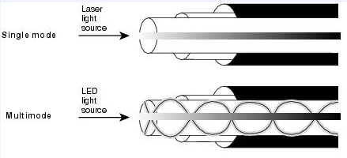
Optical Fibre (an overview)
Optical fibre cabling is used in LANs, especially in cases where electromagnetic interference (EMI) is a problem (as light travels in fibre)
Advantages of optical fibre cable over copper (UTP/STP)
DATA RATE: Optical fibre networks operate at high data rate
DISTANCE: Signals can be transmitted further without the need to be repeated or strengthened.
RESISTANCE: Immune to electromagnetic interference such as radios, motors or other nearby cables.
MAINTENANCE: Optical fibre costs much less to maintain but more costly (in terms of cable cost and interfaces); no short circuit thus fire safety is good
2 main types of optical fibre cable:
single-mode
laser light source for transmission
multimode
LED light source for transmission
Notes:
EMI (Electromagnetic Interference)
RFI (Radio Frequency Interference)
Although the terms EMI and RFI are often used interchangeably, EMI is actually any frequency of electrical noise, whereas RFI is a specific subset of electrical noise on the EMI spectrum.
Radiated RFI is emitted through the air.

Slide 14


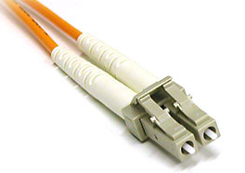
Optical Fibre Cabling
Optical fibre cables can come with different types of connector
Here are some common ones
ST Connector – commonly used for multimode fibre
SC Connector – commonly used for single-mode fibre
LC Connector - highly favored for single-mode fibre

Slide 15
Research Activity
In your home network, discover the following:
Which devices are connected by a Optical Fibre cable?
Is it single-mode or multimode?
What connectors are used on the cable?
With only one fibre, what technique is used to support upload and download streams simultaneously.
Notes:
Needed for the Assignment.

Slide 16
Factors in Network Cable Performance
The main objective in network transmission is to maximize bandwidth (volume of data) to achieve high speed and reliability with minimal error.
Different types of transmission media are made to combat different negative factors and enhance different good factors
The factors to consider when selecting the desired transmission media are:
Max speed/data rate and distance
Electromagnetic interference
Security
Fire safety
Ease of installation
Ease of maintenance
Relative cost

Slide 17
Data Rate
Measured in Kbps, Mbps and Gbps
The maximum data rate for a cable is affected by attenuation and interferences.
Potentially, optical fibre cables have the highest data rate (> 10Gbps)
Unshielded twisted pairs (UTP) are next (up to 10 Gbps)
Wireless (radio waves) has the lowest data rate mainly because of attenuation and interference.

Slide 18
Recap - Type of cables used for different Ethernet standards
Ethernet PHY Standard | Speed / Data Rate | Cable Type | Maximum Distance
100 Base-TX | 100 Mbps | UTP – Cat 5 | 100 m
100 Base-FX |  | Optical Fibre (multi-mode) | 400m (half duplex) 2 km (full duplex)
1000 Base-T | 1 Gbps | UTP – 5e or 6 | 100 m
1000 Base-TX |  | UTP – Cat 6 | 100 m
1000 Base-SX |  | Optical Fibre – multi-mode | 550 m
1000 Base-LX |  | Optical Fibre | 550 m (multi-mode) 5 km (single-mode)
10G Base-T | 10 Gbps | UTP - Cat 6 & 6a | 55 m (Cat 6) 100 m (Cat 6a)
10G Base-SR |  | Optical Fibre – multi-mode | 300 m
10G Base-LR |  | Optical Fibre – single-mode | 10 km
(SR- short reach & LR – long reach)

Slide 19
Interference
Optical fibres are immune to electromagnetic induction as they are made from non-electrical conductors material
Unshielded twisted pairs (UTP) are susceptible to interference.
Twisting the pair of wires used to connect a transmitting circuit to a
receiver also reduces interference to some degree.
Shielded twisted pairs (STP) cables are more protected from interference by shielding with a metallic screen.
Wireless (radio waves) is the most susceptible to interference

Slide 20
Mechanical Factors
Optical fibres are fragile and mechanical protection in the form of plastic sleeves or even steel amour (submarine cables) may be needed. They are difficult to install.
Although optical fibre cables containing only a few fibres can be made quite flexible, they cannot be bent too much lest light can escape from the fibre or the fibre may break or snap.
Optical fibre can last a long period without maintenance while twisted pairs copper cables can deteriorates over time.
Electric current flowing through copper cable poses shock, spark, and fire hazard. Optical fibre does not carry electrical current and present no such hazard.
Shielded twisted pairs are thicker and less flexible than UTP
Wireless (radio waves) the paths of the electromagnetic radiations can be blocked by objects.

Slide 21
Optical Fibre vs Twister Pairs copper cable
Immune to electrical interference (EMI, RFI) and low attenuation
High data rate and over long distances (up to 100km) for single-mode fibre
Secure medium. (Difficult to tap into fibre)
More Expensive in terms of material and installation (harder to install)
Use fibre if:
Immunity to interferences critical
High data rate over long distances is a necessity (e.g. backbone network)
Security is a top priority
Fire safety
Do not use fibre if:
Ease of installation is important
Cost is an issue

Slide 22
Activities: Network Cabling
Do the Activity 1 and 2 in the Word document.

Slide 23
Summary
Ethernet LANs use mainly 2 types of cables: Twisted pair and Optical Fibre.
2 types of Twisted Pair: STP and UTP. As STP is more expensive, most networks are implemented using UTP.
Common categories of UTP are Cat 6, 6A and 7.
Types of optical fiber are single-mode and multimode.
Selection of cables for Ethernet LANs are based on a number of factors including data rate, distance, etc.
Optical fibre performs the best in situation where electrical interference (EMI/RFI) is a problem but it is most expensive and difficult to install.
Wireless has the advantage of mobility but it is ranked below other media in terms of data rate, distance and security.

